Slide 1
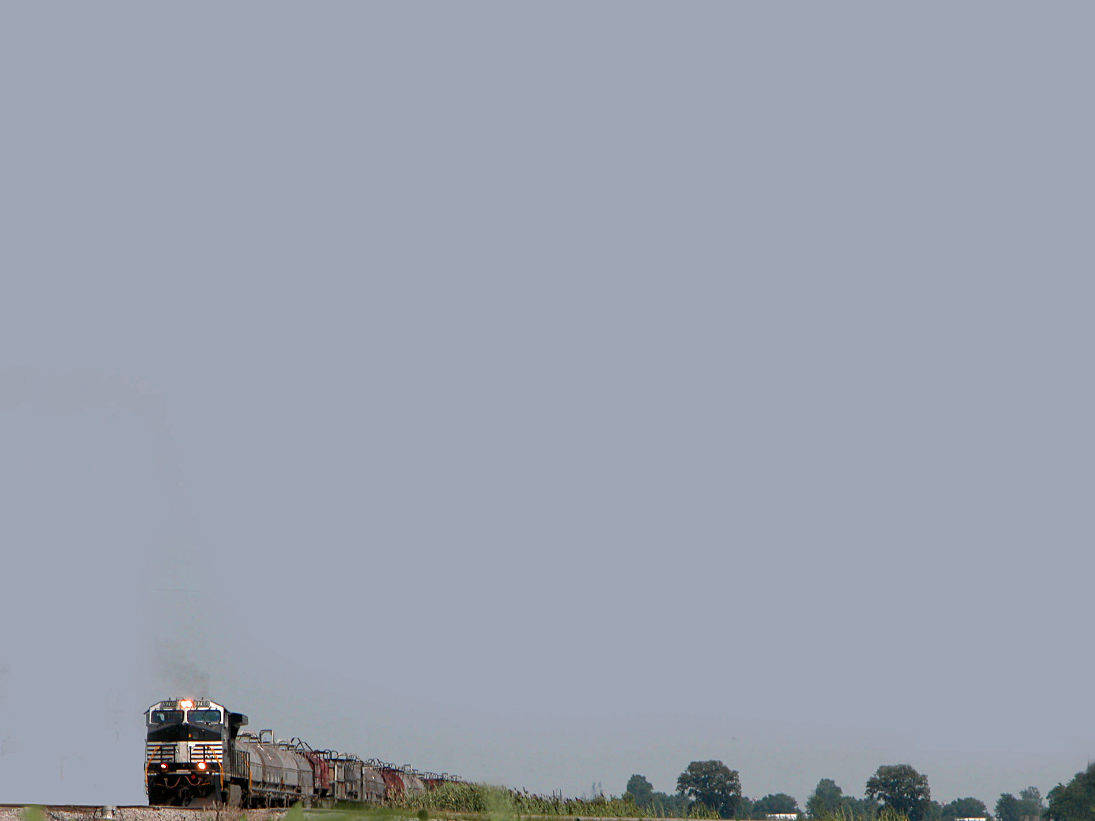
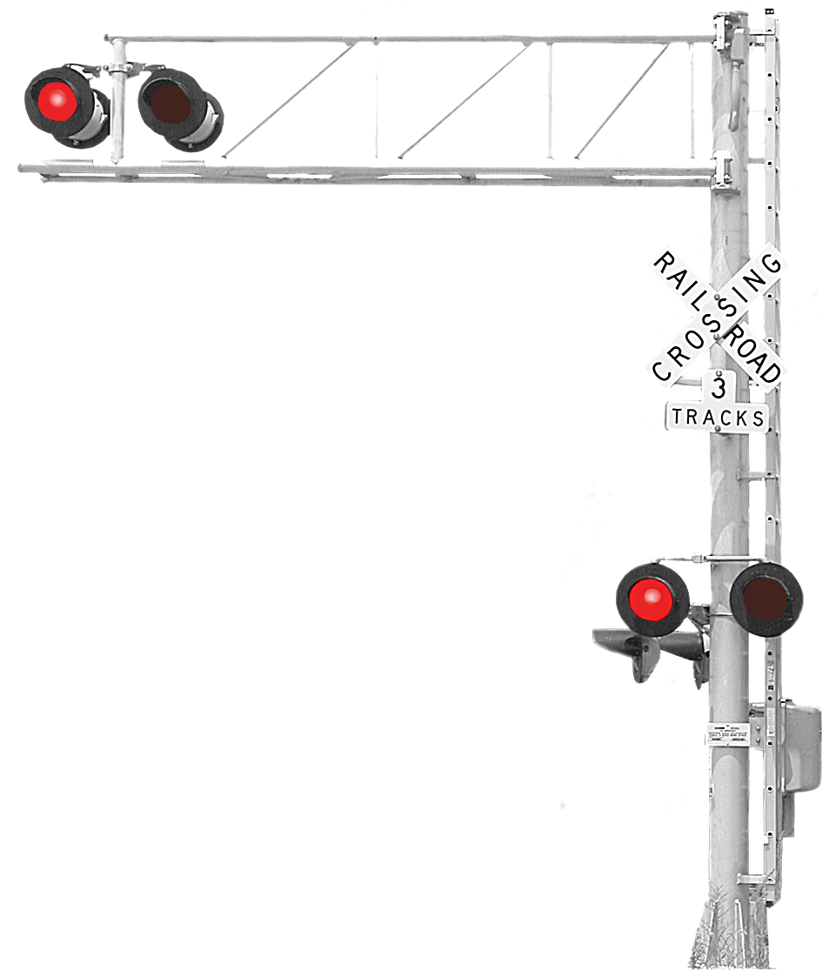
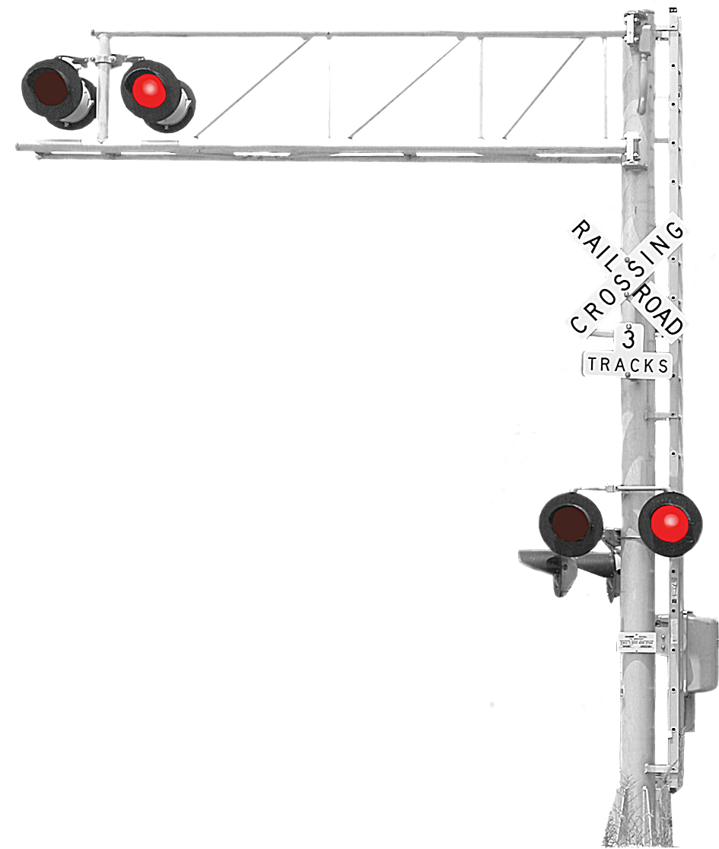
Highway-Rail Crossing Safety

Slide 2
392.12 Highway-rail crossings; safe clearance
No driver of a commercial motor vehicle shall drive onto a highway-rail grade crossing without having sufficient space to drive completely through the crossing without stopping.
Effective October 25, 2013

Slide 3

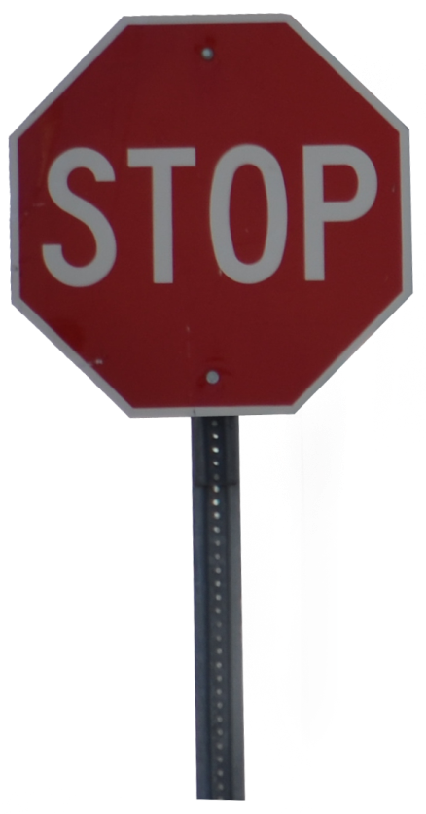
Applies to all trucks loaded or empty.
What situations could prevent you from crossing without stopping?
Traffic ahead
Traffic light just after crossing
Stop sign just after crossing

Slide 4
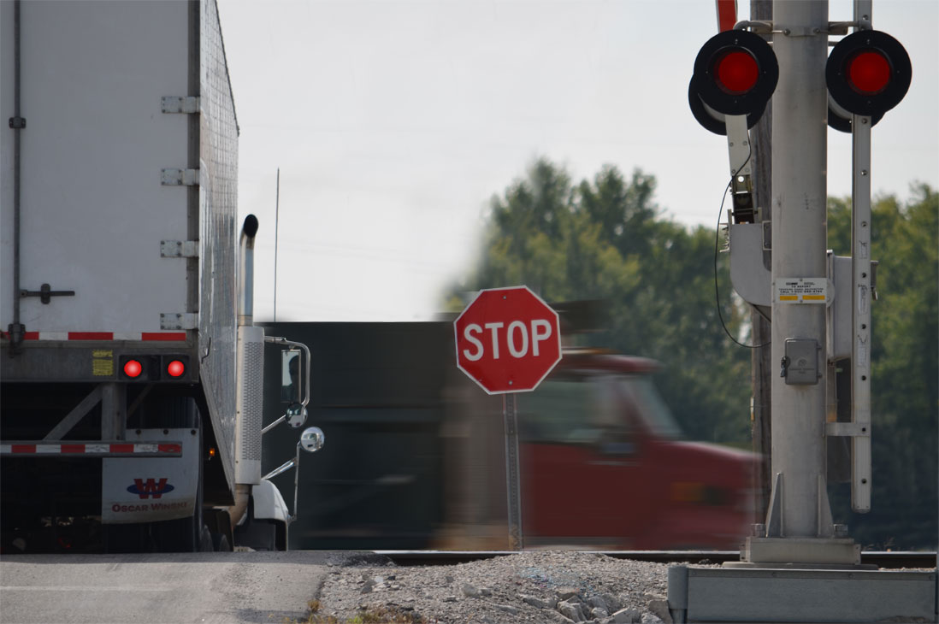
…without having sufficient space to drive completely through the crossing without stopping.
How does that affect this situation?

Slide 5
There may be some crossings you can’t use based on this new regulation.
There is no mandate that highway departments mark problem crossings.
Responsibility for compliance lies with the driver.

Slide 6
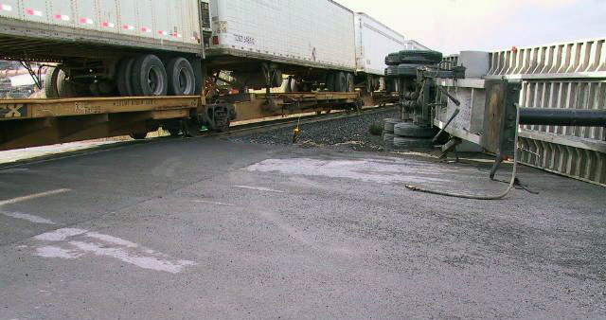
Consequences

Slide 7
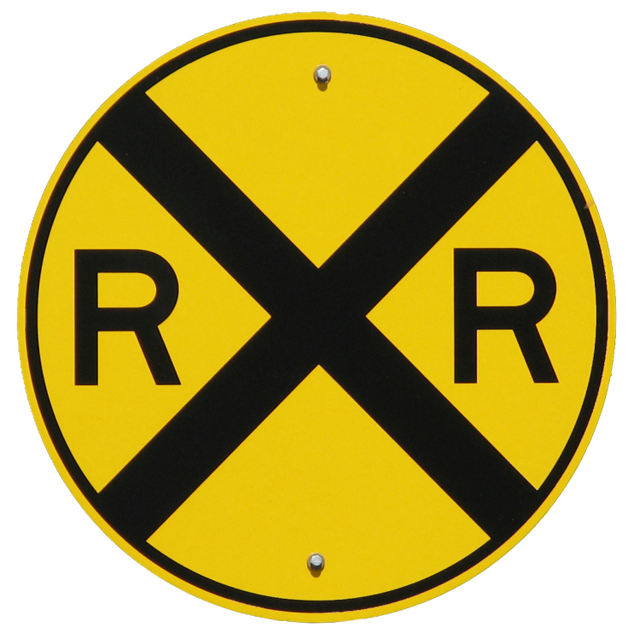
Defensive Driving
Scan crossings for problems before you
cross
© 2014 Your Company Resource • Fort Wayne, IN • www.goycr.com

Slide 8

This Power Point presentation is covered by U.S. Copyright law. The copyright holder is Your Company Resource (YCR), Fort Wayne, IN. YCR grants you the right to use the presentation and distribute it within your company without charge for use in corporate training and information sessions. However, you may not:
Sell this Power Point
Bundle this Power Point with other products for sale or distribution outside your company.
Use any or all of the content of this Power Point in another work distributed outside your company.
For further information contact:
Your Company Resource
6409 Trier Road
Fort Wayne, IN 46815
260-341-0564
tom@goycr.com
© 2014 Your Company Resource LLC • Fort Wayne, IN • www.goycr.com

