Slide 1
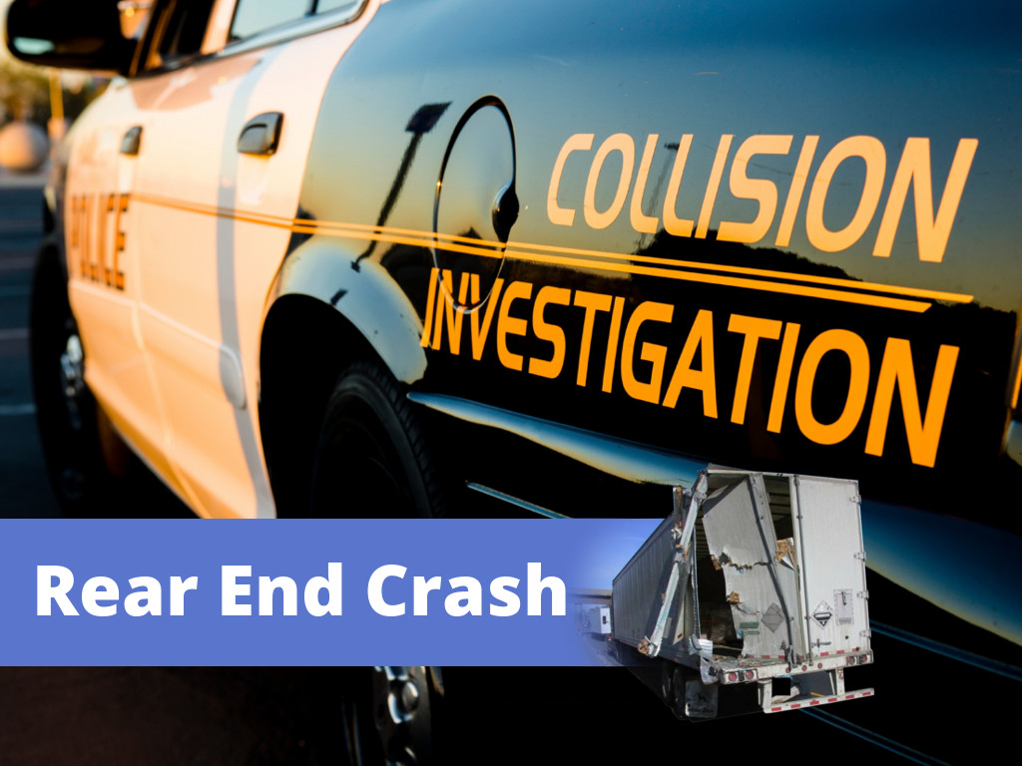

Slide 2
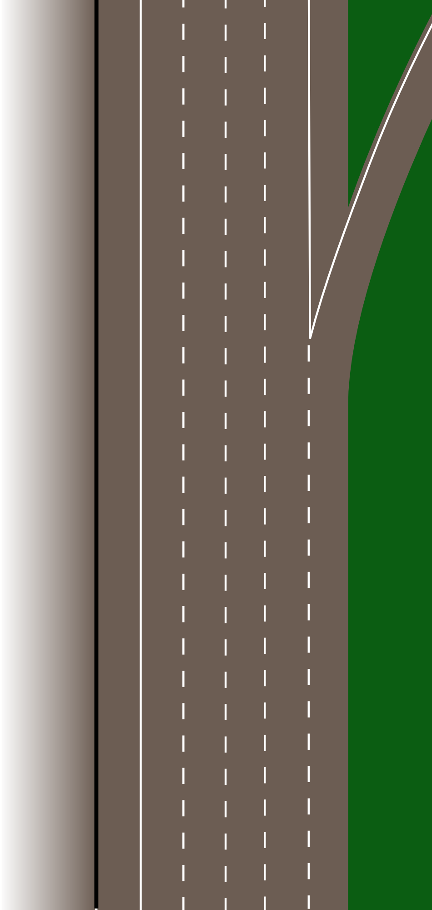




Scenario:
Two trucks were moving northbound in the 2nd lane of a five-lane interstate highway with a 55 mph speed limit. Conditions were daylight and dry. Lane one was an exit-only off ramp.
Kenworth T600 tractor hauling a van semi-trailer loaded with 27,888 pounds of corrosive floor stripper in plastic bottles.
Kenworth T800 tractor hauling a low boy three axle semi trailer. The trailer was loaded with a large “refrigeration house” that weighed 26,000 pounds.

Slide 3
Scenario:
Event 1:
Car cuts across lane in front of truck and continues down exit ramp.
Truck in front brakes heavily and avoids colliding with the car
Event 2:
Second truck brakes, swerves left but collides with left rear corner of trailer ahead. Truck continues to the left and stops on the inside shoulder against the barrier.
During this event the cab is torn loose and comes to a stop behind the truck on the shoulder and against the barrier.
Event 3:
Truck continues to park on shoulder
Detached cab comes to rest here.

Slide 4
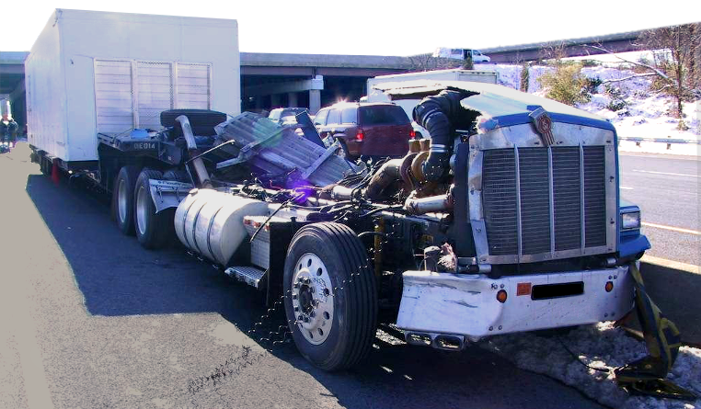
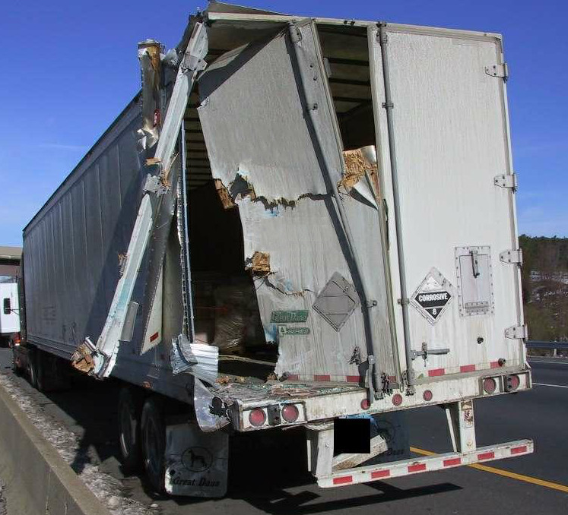
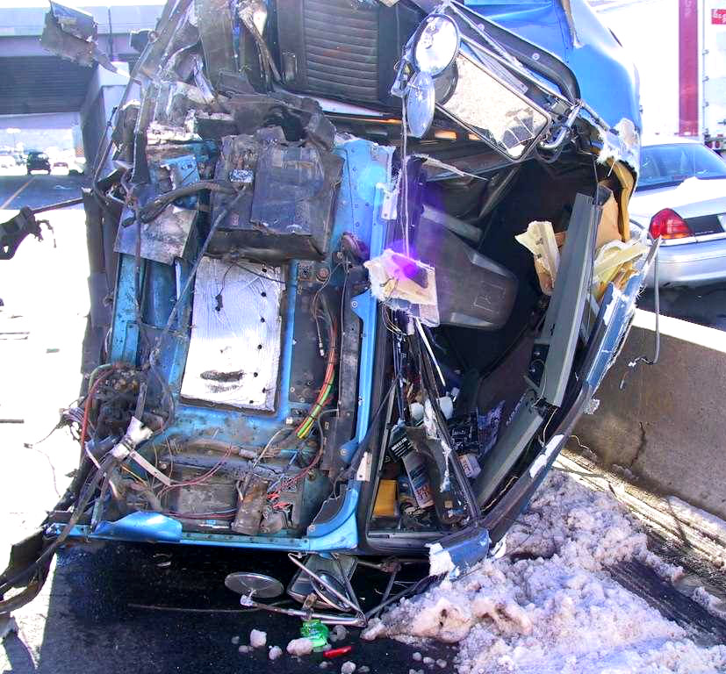
Outcome:

Slide 5
Outcome:
Amazingly the driver of the flatbed was released after treatment at a local hospital emergency room. A post-crash truck inspection discovered no violations, but the driver was issued citations and found at fault in the crash.
The driver of the other truck was uninjured and received no treatment. A Level 1 inspection found only crash related violations and the driver wasn't issued a citation for the crash.
Two witnesses verified that a car cut in front of the first truck near the interchange forcing it to slow abruptly. The car was never identified.

Slide 6
Analysis:
What caused this accident?
Should the driver of the flatbed have been found at fault ?
Did following distance play a critical role?
Could the driver of the flatbed have taken action to prevent this accident?

Slide 7

“If the person ahead of me suddenly slows, what will happen?”
If the answer is: “I’ll probably hit them”, then you’re following too closely!

Slide 8
Following distance gives you time to take defensive action rather than a panicked reaction!
© 2013 Your Company Resource • Fort Wayne, IN • www.goycr.com

Slide 9

This Power Point presentation is covered by U.S. Copyright law. The copyright holder is Your Company Resource (YCR), Fort Wayne, IN. YCR grants you the right to use the presentation and distribute it within your company without charge for use in corporate training and information sessions. However, you may not:
Sell this Power Point
Bundle this Power Point with other products for sale or distribution outside your company.
Use any or all of the content of this Power Point in another work distributed outside your company.
For further information contact:
Your Company Resource
6409 Trier Road
Fort Wayne, IN 46815
260-341-0564
tom@goycr.com
© 2013 Your Company Resource LLC • Fort Wayne, IN • www.goycr.com

